Slide 1
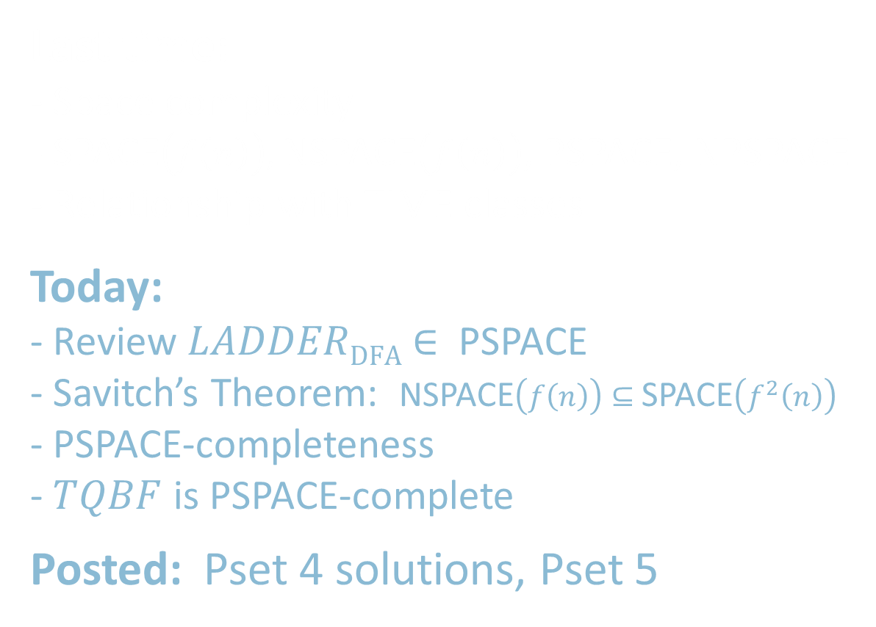
18.404/6.840 Lecture 18
Last time:
- Space complexity
- SPACE$\left(f\left(n\right)\right),$NSPACE$\left(f\left(n\right)\right)$, PSPACE, NPSPACE
- Relationship with TIME classes
Today:
- Review $LADDER\text{DFA}$ $∈$ PSPACE
- Savitch’s Theorem: NSPACE$\left(f\left(n\right)\right)⊆$SPACE$\left(f^{2}\left(n\right)\right)$
- PSPACE-completeness
- $TQBF$ is PSPACE-complete
Posted: Pset 4 solutions, Pset 5
shrink me →

Slide 2

Review: SPACE Complexity
Defn: Let $f: ℕ→ℕ$ where $f\left(n\right)≥n$. Say TM $M$ runs in space $f(n)$ if $M$ always halts and uses at most $f(n)$ tape cells on all inputs of length $n$.
An NTM $M$ runs in space $f(n)$ if all branches halt and each branch uses at most $f(n)$ tape cells on all inputs of length $n$.
SPACE$\left(f\left(n\right)\right)=\{B|$some 1-tape TM decides $B$ in space $O\left(f\left(n\right)\right)\}$
NSPACE$\left(f\left(n\right)\right)=\{B|$some 1-tape NTM decides $B$ in space $O\left(f\left(n\right)\right)\}$
PSPACE $= \bigcup_{k}{\text{SPAC}\text{E}(n^{k})}$ “polynomial space”
NPSPACE $= \bigcup_{k}{\text{NSPAC}\text{E}(n^{k})}$ “nondeterministic polynomial space”
Today: PSPACE = NPSPACE
PSPACE
= NPSPACE
coNP
NP
P
Or possibly:
P = NP = coNP = PSPACE

Slide 3
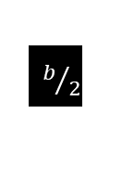
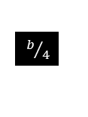

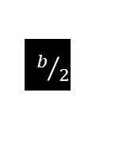







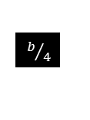
Review: $LADDER\text{DFA}$ $∈$ PSPACE
Theorem: $LADDER\text{DFA}$ $∈$ SPACE$(n^{2})$
Proof: Write $u$ $\underset{→}{ b } v$ if there’s a ladder from $u$ to $v$ of length $≤b$.
Here’s a recursive procedure to solve the bounded DFA ladder problem:
$BOUNDED$-$LADDER\text{DFA}$ $= \left\{〈B,u,v,b〉\right| B$ a DFA and $u \underset{→}{ b } v$ by a ladder in $L(B)\}$
$B$-$L=$“On input $〈B,u,v,b〉$ Let $m=\left|u\right|=|v|$.
1. For $b=1$, accept if $u,v∈L(B)$ and differ in $≤1$ place, else reject.
2. For $b>1$, repeat for each $w∈L(B)$ of length $|u|$
3. Recursively test $u\underset{→}{b/2}w$ and $w\underset{→}{b/2}v$ [division rounds up]
4. Accept both accept.
5. Reject [if all fail].”
Test $〈B,u,v〉∈LADDER\text{DFA}$ with $B$-$L$ procedure on input $〈B,u,v,t〉$ for $t={\left|Σ\right|}^{m}$
WORK
PLAY
$b/4$
recurse
AAAB
$b/2$
AAAC
AAAA
AAAD
AAAZ
AABA
AABB
BOOK
$b/4$
AAAB
AAAC
AAAA
AAAD
AAAZ
AABA
AABB
ABLE
$$b$$
AAAB
AAAC
AAAA
AAAD
AAAZ
AABA
AABB
recurse
CALL
$b/2$
Space analysis:
Each recursive level uses space $O\left(n\right)$ (to record $w$).
Recursion depth is $\log{t}=O\left(m\right)=O(n)$.
Total space used is $O(n^{2})$.
$$B\text{−}L$$
AAAB
AAAC
AAAA
AAAD
AAAZ
AABA
AABB
ABLE
AAAB
AAAC
AAAB
AAAC
AAAA
AAAD
AAAZ
AABA
AABB
CALL
AAAA
AAAD
AAAZ
AABA
AABB
BOOK
$$u$$
$$v$$
$$w$$
$$w$$

Slide 4
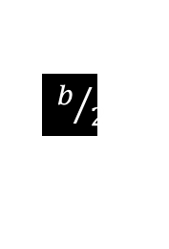







PSPACE = NPSPACE
Savitch’s Theorem: For $f\left(n\right)≥n$, NSPACE$\left(f\left(n\right)\right)⊆$ SPACE$\left(f^{2}\left(n\right)\right)$
Proof: Convert NTM $N$ to equivalent TM $M$, only squaring the space used.
For configurations $c_{i}$ and $c_{j}$ of $N$, write $c_{i}$ $\underset{→}{ b } c_{j}$if can get from $c_{i}$ to $c_{j}$ in $≤b$ steps.
Give recursive algorithm to test $c_{i}$ $\underset{→}{ b } c_{j}$:
$M =$ “On input ${c_{i}, c}_{j}, b$ [goal is to check $c_{i}$ $\underset{→}{ b } c_{j}$]
1. If $b=1$, check directly by using $N$’s program and answer accordingly.
2. If $b>1$, repeat for all configurations $c_{mid}$ that use $f(n)$ space.
3. Recursively test $c_{i}$ $\underset{→}{ b/2 } c_{mid}$ and $c_{mid}$ $\underset{→}{ b/2 } c_{j}$
4. If both are true, accept. If not, continue.
5. Reject if haven’t yet accepted.”
Test if $N$ accepts $w$ by testing $c_{start}$ $\underset{→}{ t } c_{accept}$ where $t$ = number of configurations
= $\left|Q\right|×f\left(n\right)×d^{f\left(n\right)}$
$$f(n)$$
$q_{0}w_{1}⋯w_{n}$
$$⋯ q\text{accept} ⋯$$
˽ … ˽
$b/2$
recurse
aaba$q_{7}$da$⋯$cab
$$b$$
$b/2$
Each recursion level stores 1 config = $O\left(f\left(n\right)\right)$ space.
Number of levels = $\log{t}=O\left(f\left(n\right)\right)$. Total $O\left(f^{2}\left(n\right)\right)$ space.
recurse

Slide 5


PSPACE-completeness
Defn: $B$ is PSPACE-complete if
$B∈$PSPACE
For all $A∈$PSPACE, $A≤_{P}B$
If $B$ is PSPACE-complete and $B∈$P then P $=$ PSPACE.
Why $≤_{P}$ and not $≤_{PSPACE}$ when defining PSPACE-complete?
- Reductions should be “weaker” than the class. Otherwise all problems in the class would be reducible to each other, and then all problems in the class would be complete.
Theorem: $TQBF$ is PSPACE-complete
PSPACE-complete
Check-in 18.1
Knowing that $TQBF$ is PSPACE-complete, what can we conclude if $TQBF∈$ NP? Check all that apply.
P = PSPACE
NP = PSPACE
P = NP
NP = coNP
NP-complete
PSPACE =
NPSPACE
NP
P
Think of complete problems as the “hardest” in their associated class.
Check-in 18.1

Slide 6


Slide 7


$TQBF$ is PSPACE-complete
Recall: $TQBF=\left\{〈φ〉\right| φ$ is a QBF that is True$\}$
Examples: $φ_{1}=∀x ∃y \left[\left(x∨y\right)∧\left(\overline{x}∨\overline{y}\right)\right]∈TQBF$ [True]
$φ_{2}=∃y ∀x \left[\left(x∨y\right)∧\left(\overline{x}∨\overline{y}\right)\right]∉TQBF$ [False]
Theorem: $TQBF$ is PSPACE-complete
Proof: 1) $TQBF∈$PSPACE ✓
2) For all $A∈$PSPACE, $A≤_{P}TQBF$
Let $A∈$ PSPACE be decided by TM $M$ in space $n^{k}$.
Give a polynomial-time reduction $f$ mapping $A$ to $TQBF$.
$f: Σ^{∗}→$QBFs
$f\left(w\right) = 〈φ_{M,w}〉$
$w∈A$ iff $φ_{M,w}$ is True
Plan: Design $φ_{M,w}$ to “say” $M$ accepts $w$. $φ_{M,w}$ simulates $M$ on $w$.

Slide 8






Constructing $φ_{M,w}$: 1st try
Tableau for $M$ on $w$
$$n^{k}$$
Recall: A tableau for $M$ on $w$ represents
a computation history for $M$ on $w$
when $M$ accepts $w$.
Rows of that tableau are configurations.
$M$ runs in space $n^{k}$, its tableau has:
- $n^{k}$ columns (max size of a configuration)
- $d^{\left(n^{k}\right)}$ rows (max number of steps)
Constructing $φ_{M,w}$. Try Cook-Levin method.
Then $φ_{M,w}$ will be as big as tableau.
But that is exponential: $n^{k}×d^{\left(n^{k}\right)}$.
Too big! ☹
˽ … ˽
$$q_{0}$$ | $$w_{1}$$ | $$w_{2}$$ | $w_{3} ⋯ w_{n}$
a | $$q_{7}$$ | $$w_{2}$$ | $⋯$
 |  |  | $⋯ q\text{accept} ⋯$
$$d^{{(n}^{k})}$$

Slide 9












Constructing $φ_{M,w}$: 2nd try
hide →
Tableau for $M$ on $w$
For configs $c_{i}$ and $c_{j}$ construct $φ_{c_{i}, c_{j}, b}$ which “says” $c_{i}$ $\underset{→}{ b } c_{j}$ recursively.
$φ_{c_{i}, c_{j}, b}=∃c_{mid}\left[ φ_{c_{i},{ c}_{mid}, b/2} ∧ φ_{c_{mid}, c_{j}, b/2} \right]$
$$n^{k}$$
˽ … ˽
$$q_{0}$$ | $$w_{1}$$ | $$w_{2}$$ | $w_{3} ⋯ w_{n}$
a | $$q_{7}$$ | $$w_{2}$$ | $⋯$
 |  |  | $⋯ q\text{accept} ⋯$
$∃x_{1},x_{2},⋯,c_{l}$
as in Cook-Levin
$$∃c_{mid}\left[{φ }_{, , b/4} ∧ {φ }_{, , b/4}\right]$$
$$∃c_{mid}\left[{φ }_{, , b/4} ∧ {φ }_{, , b/4}\right]$$
$$d^{{(n}^{k})}$$
$$⋮$$
Check-in 18.2
Why shouldn’t we be surprised that this construction fails?
We can’t define a QBF by using recursion.
It doesn’t use $∀$ anywhere.
We know that $TQBF∉$ P.
${φ }_{, , 1}$ defined as in Cook-Levin
$$⋮$$
$$∃c_{mid}[{φ }_{, , b/8}⋯]$$
$$φ_{M,w}=φ_{c_{start}, c_{accept}, t}$$
$t=d^{\left(n^{k}\right)}$
Size analysis:
Each recursive level doubles number of QBFs.
Number of levels is $\log{d^{\left(n^{k}\right)}=O\left(n^{k}\right)}$.
→ Size is exponential. ☹
Check-in 18.2

Slide 10




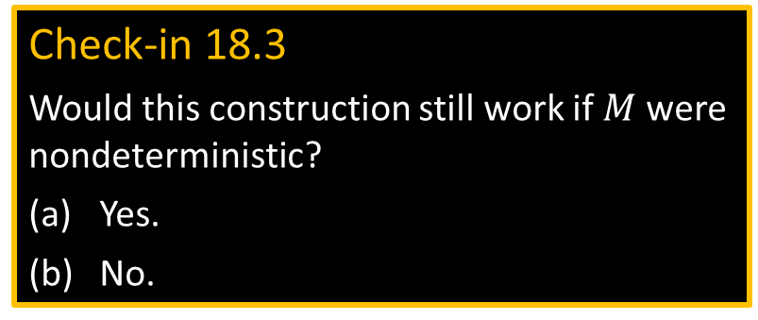


Constructing $φ_{M,w}$: 3rd try
$φ_{c_{i}, c_{j}, b}=∃c_{mid}\left[ φ_{c_{i},{ c}_{mid}, b/2} ∧ φ_{c_{mid}, c_{j}, b/2} \right]$
∀𝑐𝑔, 𝑐h∈ 𝑐𝑖, 𝑐mid𝑐𝑗, 𝑐mid, 𝑐𝑗𝑐𝑗𝑎𝑏𝜙𝑐𝑔, 𝑐h, 𝑏/2
$∀(x∈S) \left[ ψ \right]$
is equivalent to
$∀x \left[\left(x∈S\right) \underset{→}{ } ψ\right]$
$$⋮$$
$$φ_{M,w}=φ_{c_{start}, c_{accept}, t}$$
$t=d^{\left(n^{k}\right)}$
${φ }_{, , 1}$ defined as in Cook-Levin
Check-in 18.3
Would this construction still work if $M$ were nondeterministic?
Yes.
No.
Size analysis:
Each recursive level adds $O(n^{k})$ to the QBF.
Number of levels is $\log{d^{\left(n^{k}\right)}=O\left(n^{k}\right)}$.
→ Size is $O\left(n^{k}×n^{k}\right)=O\left(n^{2k}\right)$ ☺
Check-in 18.3

Slide 11

Quick review of today
$LADDER\text{DFA}$ $∈$ PSPACE
Savitch’s Theorem: NSPACE$\left(f\left(n\right)\right)⊆$SPACE$\left(f^{2}\left(n\right)\right)$
$TQBF$ is PSPACE-complete

